Slide 1
RL vs Deep-RL in Mariokart Wii
Harry Stevenson
Supervisor – Leandro Minku

Slide 2


RL vs Deep-RL
Reinforcement Learning
(Q-Learning)
Deep Reinforcement Learning
(DQN)
Q-Table of state-action value pairs
Action chosen by ε-greedy policy
3 parameters
Exploration Rate: ε
Discount Factor: γ
Learning Rate: α
(1 for deterministic environments)
Deep-NN to approximate Q-Function
Trained to minimise loss function by gradient descent on samples from replay buffer
Transitions: $S_{t}+$ $A_{t}$ +$R_{t+1}$ +${\text{γ}}_{t+1}$ +$S_{t+1}$
Loss Function:
Image: ‘Rainbow: Combining Improvements in Deep Reinforcement Learning‘ : https://arxiv.org/abs/1710.02298

Slide 3
Comparison Motivations
Performance
Time
Computation
Generalisation Capability
Apply to unseen track
Input Robustness
Agent in real race
Scalability

Slide 4
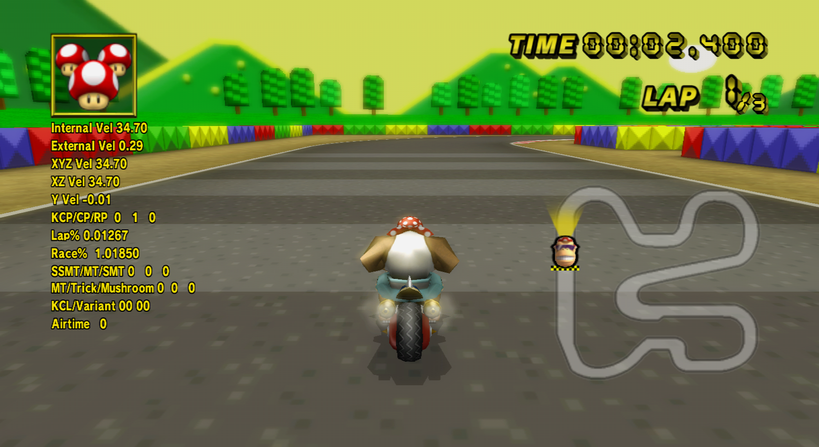
RL in Mariokart Wii
Run in Dolphin Emulator
State Space
Speed
Race% (~position)
Miniturbo Charge
Action Space
B – Brake/Drift/Hop
Up – Wheelie
Control Stick – Steer
Altered policy
Screenshot from MarioKart

Slide 5

Deep-RL in Mariokart Wii
Rainbow Agent
Deep-RL Agent
Combines many improvements to Deep-RL
Duelling Networks
Prioritised Experience Replay
Distributional RL
…
Example frame used as input to

Slide 6
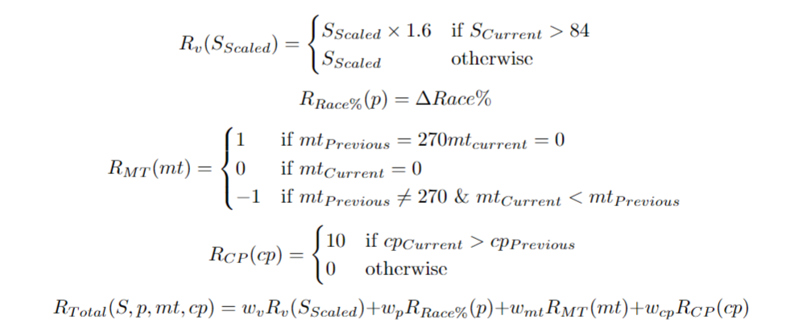
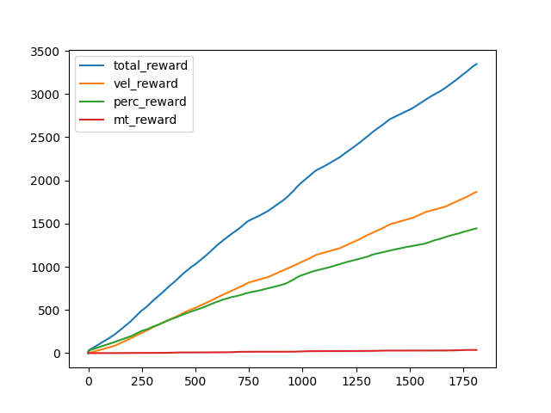
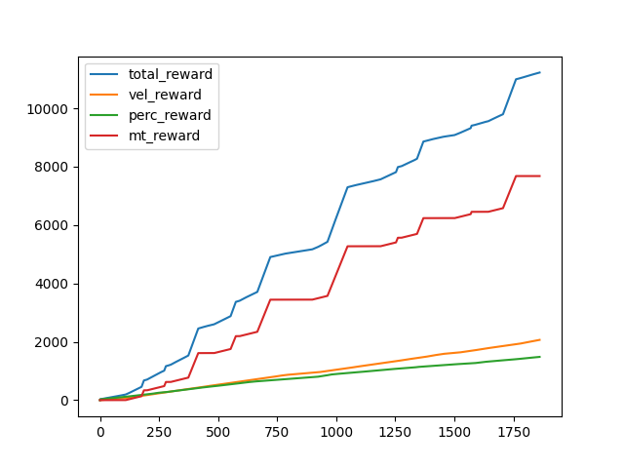
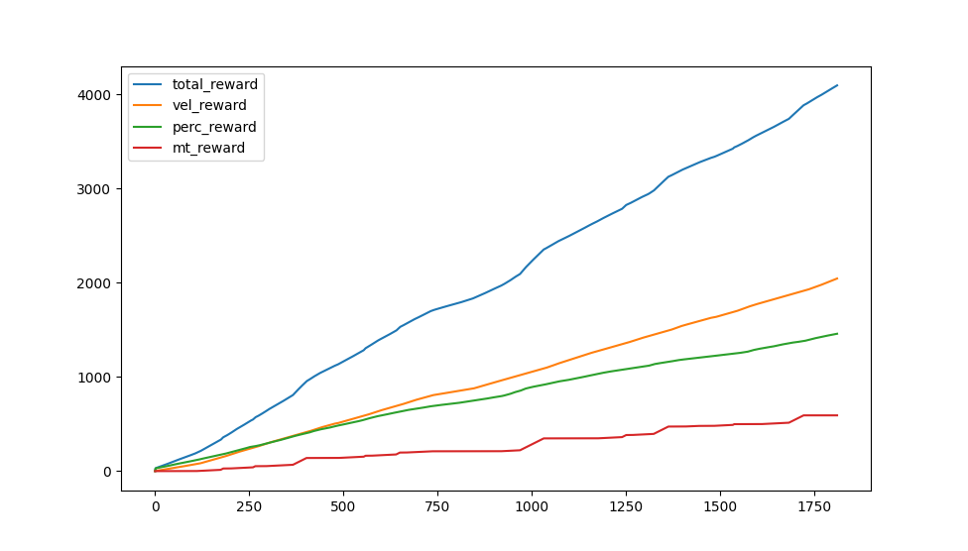
Reward Function Design
4 Components
Speed
Progress
Miniturbo (bonus)
Checkpoint (bonus)
Weights
(Before checkpoint reward was added)

Slide 7
Live Demo

Slide 8
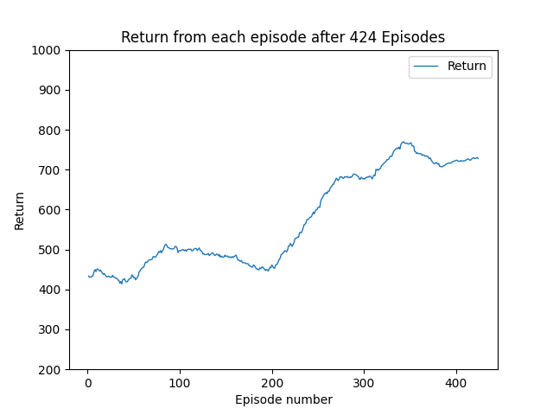
Evaluation
Total Reward value
Survival Time

Slide 9
Next Steps
Reward Function
Tune weights
Add reward for survival
Improve policy to proportionally explore/exploit
DQN
Training
Data Collection

